Slide 1
AN ANALYSIS OF SPENDING PATTERNS IN MEN AND WOMEN
SDG 5: Gender Equality
Presented by Data Riders (Group 10)
Data Science and AI – Cohort 5

Slide 2
ACKNOWLEDGMENT
Ivy Odametey
Clifford Frempong

Slide 3
INTRODUCTION
Past decades have seen a huge gender gap between men and women. Men had more access to education, financial services, land and property than women.
SDG 5 - Gender equality entails women and girls having equal access to opportunities and resources as much as their male counterpart. Efforts have been ongoing to ensure this is achieved by 2030.
An analysis of spending patterns of men and women was conducted to determine if there is a gap and the extent of this gap. The analysis was done using a survey of men and women who visited a mall.

Slide 4
Research Questions
What was the head count of the men and women surveyed?
What was the age group of the men and women surveyed?
What was the average annual income for both men and women?
What was the average annual income for men and women across the age groups?
What was the average spending score for both men and women?
Which gender had the greater spending power?

Slide 5
Research Methodology
Problem identification: Problem statement formation.
Data Wrangling: Identification of data source (Kaggle) - Survey of customers at a mall was done to determine their age, sex and annual income.
Data Cleaning: checked for empty rows and checked to see if some columns were needed or be removed.
Data Analysis: Data exploration was done by using feature engineering to carry out addition of two new conditional columns (Age group and Spending score group) to better interpret the already existing data. Also, data visualization was done using Power BI to answer the research questions from the survey.

Slide 6
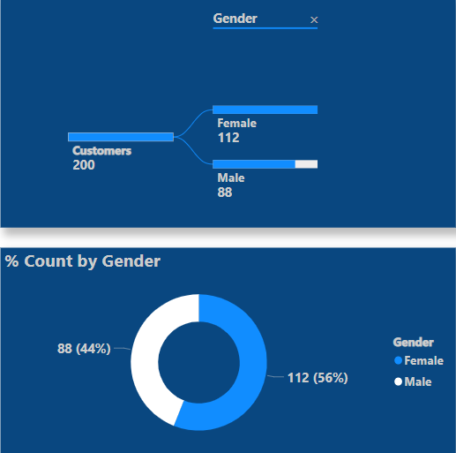
Research Question 1
What was the head count of the men and women surveyed?

Slide 7
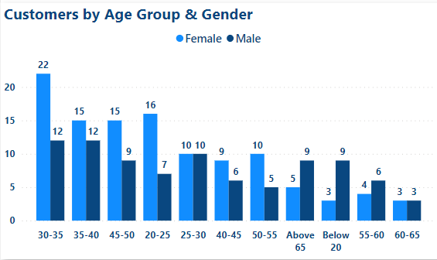
Research Question 2
What was the age group of the men and women surveyed?
Age Group | Female | Male
Below 20 | 3 | 9
20 - 25 | 16 | 7
25 – 30 | 10 | 10
30 - 35 | 22 | 12
35 – 40 | 15 | 12
40 - 45 | 9 | 6
45 – 50 | 15 | 9
50 – 55 | 10 | 5
55 – 60 | 4 | 6
60 - 65 | 3 | 3
Above 65 | 5 | 9
Total | 112 | 88

Slide 8
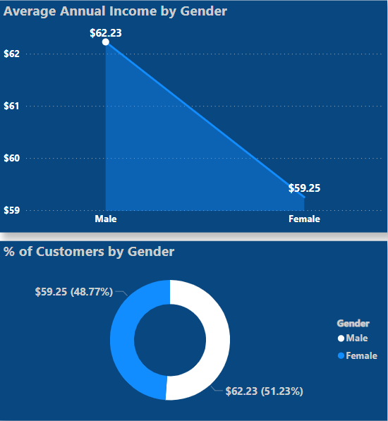
Research Question 3
What was the average annual income for both men and women?

Slide 9
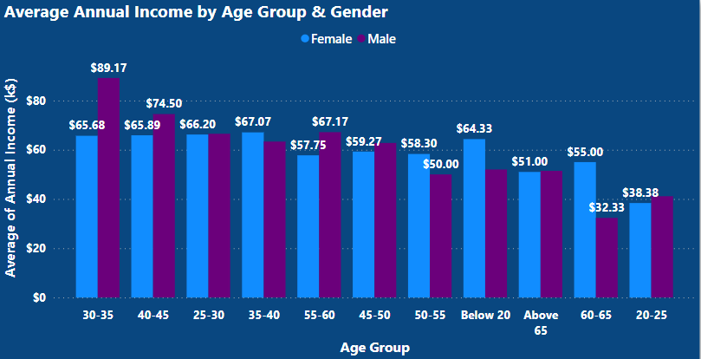
Research Question 4
What was the average annual income for men and women across the age groups?

Slide 10
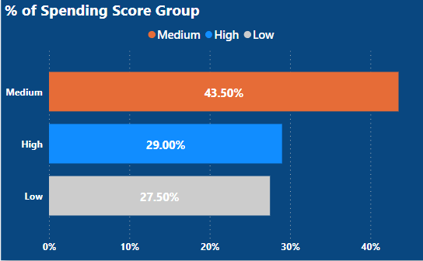
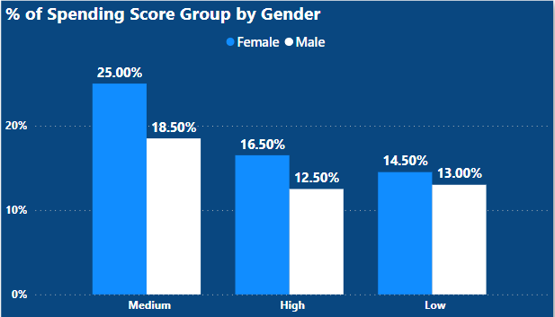
Research Question 5
What was the average spending score for both men and women?

Slide 11
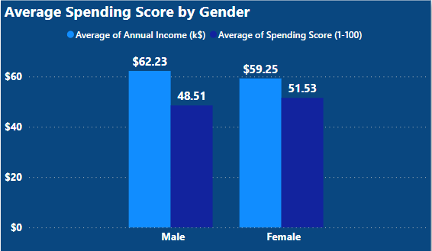
Research Question 6
Which gender had the greater spending power?

Slide 12
RECOMMENDATION
Despite the population of female customers being more than male customers, the average annual income of the male customers was more than the female customers. This is an indication that the male gender earns more than their female counterpart.
One of the reasons for this is women working unpaid hours. The latest data collected on 90 countries and territories between 2001 and 2019 indicate that, on an average day, women spend about 2.5 times as many hours as men on unpaid domestic work and care work.
To this end, we propose that equity be enforced. Women should be allowed more opportunities in the workplace.
Women should go for high skilled jobs, enroll for in demand skills and not limit themselves to traditional vocations.
Women should be allowed more access to financial services such as loans and grants.

Slide 13
CONCLUSION
By 2019, women accounted for nearly 39 per cent of the global labor force, but held only 28.3 per cent of managerial positions, a rise of 3 percentage points since 2000. The disproportionate impact of the pandemic on women in the workforce, and female entrepreneurs, threatens to roll back the little progress made in reducing the global gender gap in managerial positions.
“Gender bias is undermining our social fabric and devalues all of us. It is not just a human rights issue; it is a tremendous waste of the world’s human potential. By denying women equal rights, we deny half the population a chance to live life at its fullest. Political, economic and social equality for women will benefit all the world’s citizens. Together we can eradicate prejudice and work for equal rights and respect for all”.

Slide 14
Data Riders
Damidola Peter-Koyi
Esther Olaseinde
Igboanugo Catherine Eziamaka
Janet Odejide
Oderinde Janet Tunrayo
Oghenerukevwe Egbaiviwie
Zinat Seriki
Group 10

Slide 15
Thank you

Slide 16
REFERENCES
United Nations. (n.d). Achieve gender equality and empower all women and girls. https://sdgs.un.org/goals/goal5
The Global Goals. (n.d). Achieve gender equality and empower all women and girls. https://www.globalgoals.org/5-gender-equality
Kaggle. https://www.kaggle.com/dhiyamahdiyah/mall-customers1

